Slide 1


Pokémon Team
Builder
Team Altaria
Austin, Sarah, Ethan

Slide 2
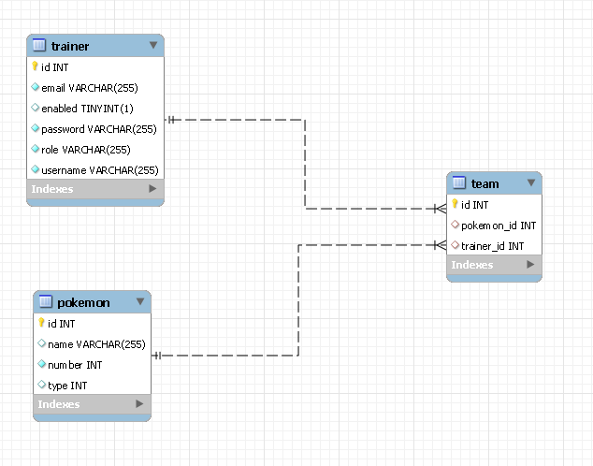
ER diagram
Notes:
Ethan

Slide 3
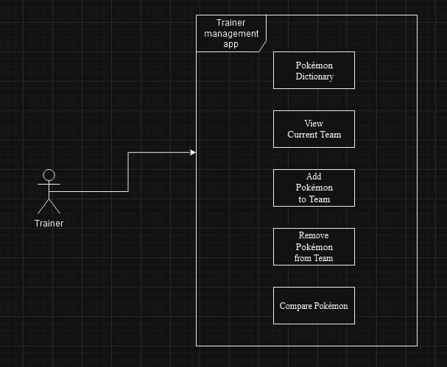
UML Diagram

Slide 4
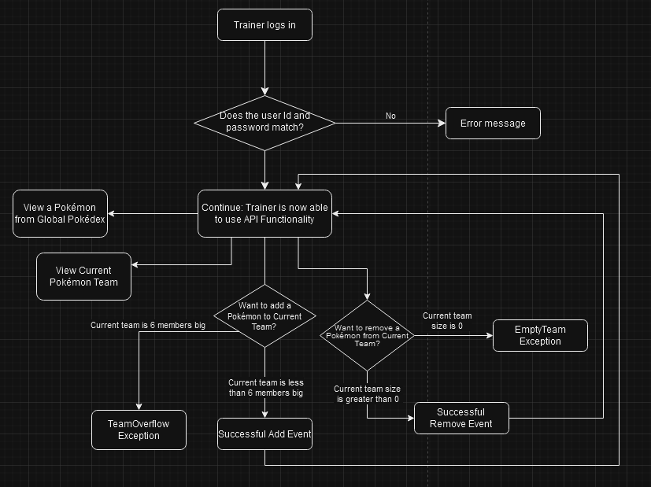
Flow Diagram
Notes:
Austin

Slide 5
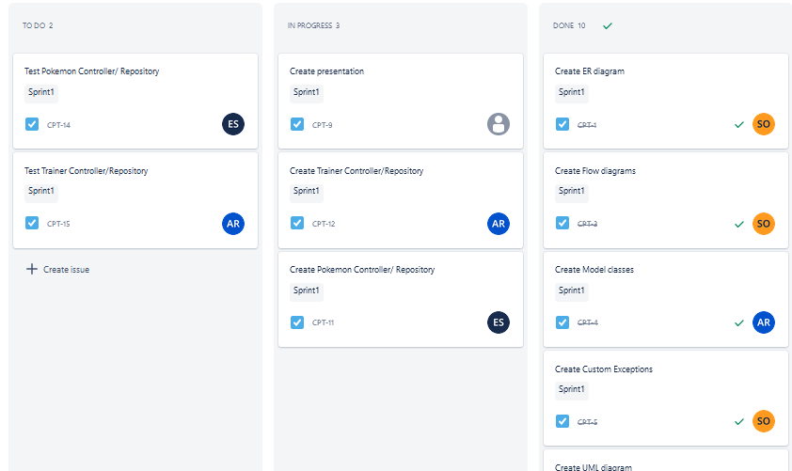
Jira Kanban Board
Notes:
Ethan

Slide 6
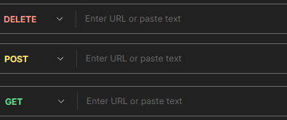


Product Demo

Slide 7
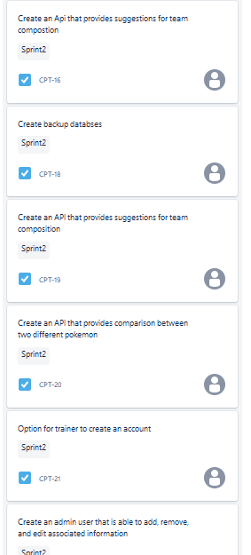
Next Sprint
Frontend UI- use pokémon sprites provided by Pokémon API
Multiple team support
Team suggestion support
Notes:
Ethan

Slide 8
Challenges
Learning how to use the Pokémon API on the job, and extracting the information we needed from it
Likewise, learning how to properly mock the Rest Templates for the external Pokémon API calls
Being able to pin down exactly what we wanted our API to do
This time around, we were very careful about watching our scope to choose an appropriate amount of functionality for the time we had to work on it
Debugging/testing application functionality
Building junit test for external API
Notes:
Austin, Sarah, Etahn

Slide 9
Lessons Learned
It really pays to tinker with an API before you go to use it in another one
There’s always something more to learn, and there certainly was a lot to learn about the Pokémon API
Our workflow was definitely helped by keeping our communications open and collaborating on sections that caused grief
Handle security and testing at start of project — check in on AWS.
Leverage GenAI for troubleshooting
Handling junit test and authentication process is important
Notes:
Austin, Sarah, Etahn

Slide 10

Q & A

